Slide 1
Classification model
For subreddit “Flair” suggestion

Slide 2
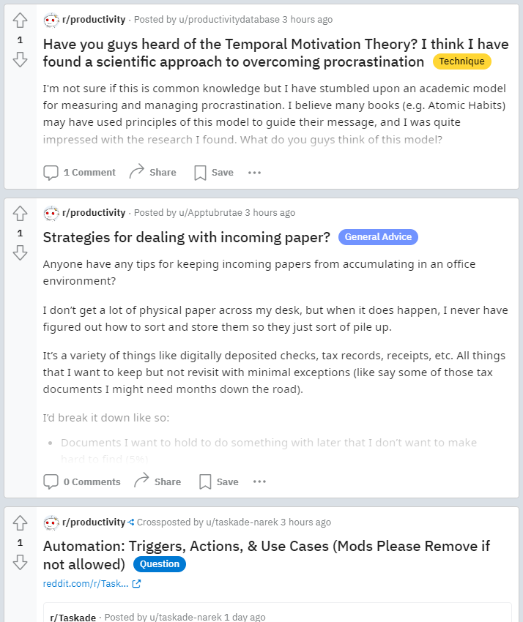
FLAIR
“TAG” of posts in subreddit

Slide 3
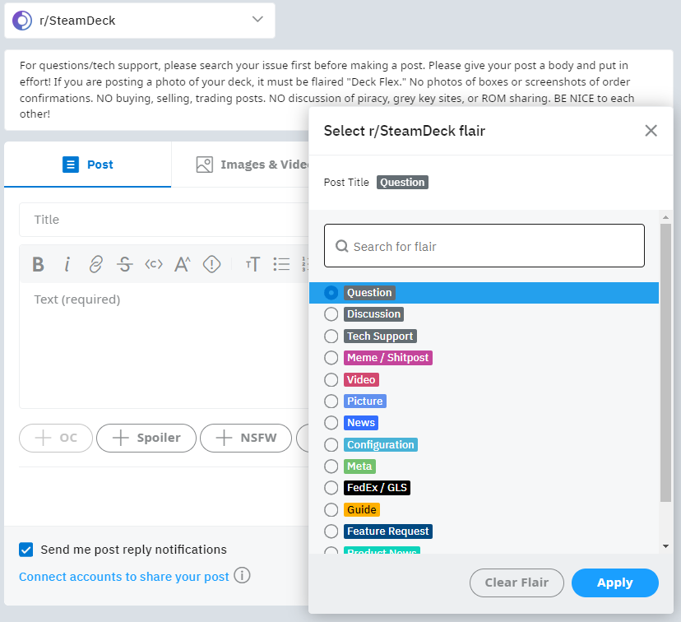
The problem
Creating new post in subreddit
Pick one flair incorrectly
Reader confused

Slide 4
The Data
Column | Description
Title | Title of post on subreddit
Selftext | Text body of the post
Tag | "Flair" name of subreddit
From Steam Deck subreddit

Slide 5
Tag to be classified
Configuration
Discussion
Question
Tech Support
MEGATHREAD
Feature Request
Guide
Hot Wasabi
Meme / Shitpost
Meta
News
Picture
Video

Slide 6
Process
Data collected from
subreddit pages
Extract “title”, “selftext” and “tag”
Process data
Remove duplicates
Using lemmatized/non-lemmatized* words
Tried and reverted
Remove posts with empty selftext
Discard selftext
Tags common words removal
Combine tags
Finalize model and simulate suggestions
Model evaluation and error analysis
Create prediction model using various algorithms
* Lemmatized = inflected forms of the same word grouped together

Slide 7
Model selection
Precision + Correctness Score (%)
Algorithm | Data | Train data | Test data
Random Forest | Over 20,000 non-lemmatized words from title and selftext | 99.7% | 50.3%
Naïve Bayes | 6,000 non-lemmatized words from title and selftext | 86% | 51.1%
Logistic Regression | 2,000 lemmatized words from title and selftext | 73.6% | 52.2%
Logistic Regression | 1,000 lemmatized words from title and selftext | 68% | 49.9%
* Words from title and selftext are considered to be different, even if it is the same word
Notes:
Actually, there are a lot more trial models than showing in the slide

Slide 8
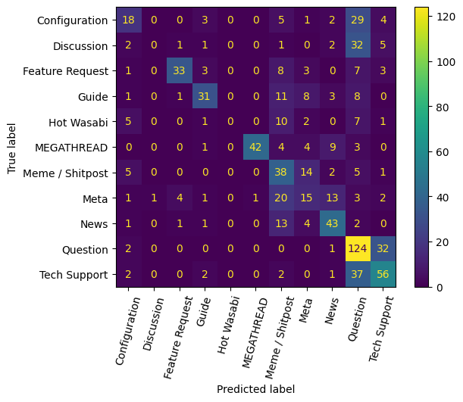
The Errors
Most errors on
Configuration
Discussion
Question
Tech Support
Some are mostly the same things.
Many off-topic posts in a tag

Slide 9
Fixing the problem
The model will be used to generate top N tags for new post instead if it doesn’t confident enough to pick only one tag.
Actual | Suggestion (suggest 1 tag if confident >= 50%) | Explanation
Guide | Meme / Shitpost (30%) News (12%) Guide (11%) | Model cannot judge, suggests top 3 possible tags, one matched
Meme / Shitpost | Question (13%) Configuration (13%) Tech Support (11%) | Model cannot judge, suggests top 3 possible tags, no match
MEGATHREAD | MEGATHREAD (71%) | Model select MEGATHREAD as a predicted result
Notes:
Percentage are probability of model to correctly predict the tag

Slide 10
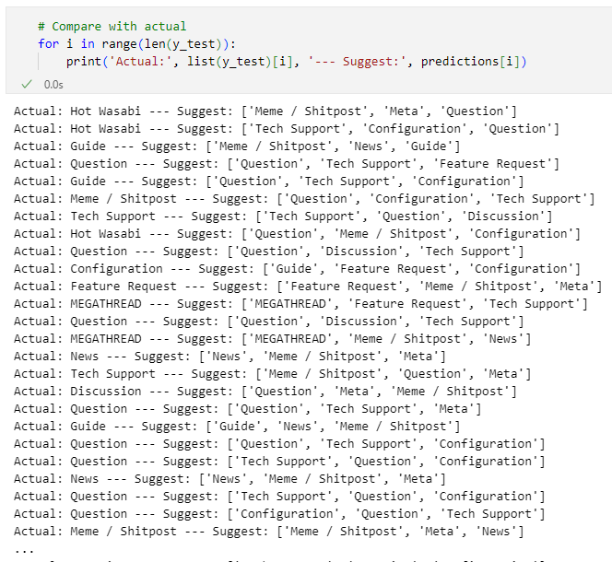
result
By setting confident percentage = model performance + some margin
(52.2% + 5% = 57.2%)
Percentage of relevant suggestion
goes up to 78.2%, which should be enough for the problem
Confident percentage and number of suggested tags can also be adjusted
to achieve even better result.
Notes:
Confident percentage and number of suggested tags can also be adjusted to get even better result

Slide 11
Limitations
The model is trained on only one subreddit, it will not work with the other subreddit. To create model for another subreddit, we may have to process the data from other subreddit differently.
The model will perform worse on tag (flair) with many off-topic posts.
To maintain the performance of tag suggestion, the model need to be retrain periodically as posts in subreddit should be continuously growing with a little bit different of language used.

